Slide 1
Demand and Sales Forecasting using Time Series Algorithm Case Study
Payel Das
Shalini
Sridar Ganesh
Ravishankar DS

Slide 2
Retail-Giant Sales Forecasting
GLOBAL MART is an online retail company who has worldwide operations in 147 countries grouped into 7 Global Market Regions. The Consumer of this company is spread across three major segments Consumer, Corporate and Home Office and it product categories are technology, furniture and office supplies.
Business Problem :
Global Mart needs to plan for Operations and Logistics. They need to finalize the plan for the next 6 months and forecast the sales and the demand for the next 6 months, that would help to manage the revenue and inventory accordingly.
Our Objective
The store caters to 7 different market segments and in 3 major categories. We need to forecast at this granular level, so we subset our data into 21 (7*3) buckets before analyzing these data.
But not all of these 21 market buckets are important from the store’s point of view. So we need to find out 2 most profitable (and consistent) segment from these 21 and forecast the sales and demand for these segments.
We need to build a Classical decomposition model and time series auto ARIMA model on sales & demand. Then we need to evaluate the best model to forecast sales and demand for each market buckets

Slide 3
Data Analysis Methodology
Business Understanding
Model Building Auto ARIMA and Classical Decomposition
Missing value Treatment
Finding the monthly Profit, Sales, Demand for all the 21 Market segment
Compute the Monthly avg.profit, Net Profit, for each Market bucket. Identifying the two target Market Buckets.
Understand the variables available in the data file using data dictionary and statistics.
Understanding data
Global Mart Dataset
Data preparation
Forecast 6 months test data using ARIMA and Classical decomposition model
Using MAPE Matrix finalize the
best model.
The best model chosen will be used to Forecast the next six months

Slide 4
Assumptions
Month.Number : We have 48 months ranging from 1st Jan 2011 to 31st Dec 2014. Hence we have derived a new metric called Month.Number ranging from 1 to 48 to determine number of months passed since Jan 2011.
US postal codes are missing and hence we will not use postal codes in our model. We are not imputing the column as we are going to ignore this column in our analysis anyway.
There are few outliers in our data. However we are not removing them since these are actual demand and sales for products & they reflect the real-life data. While doing classical decomposition we are smoothing out the series which would any way take care of any extreme values present in the series.
Multiplicative model has been trained for the global trend component for both the segments since the amplitude of sales and demand is increasing with time.
There are peaks and troughs in the series which resembles to a sinusoidal pattern. Hence we are also training multiplicative sinusoidal model to replicate the global trend.

Slide 5
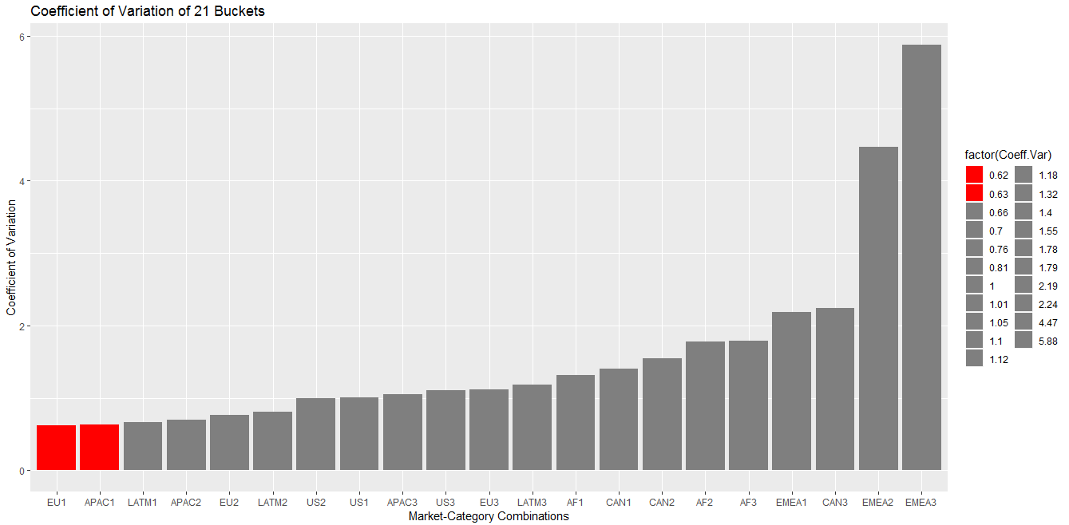
Top 2 Market segments
We have identified most profitable Market-Consumer Segment combination using coefficient of variation. Lower is the coefficient of variation lesser is the fluctuation is series and the more consistent the profit will be.
Based on the above definition we found out our top two segments which are
APAC Consumer Segment
EU Consumer Segment

Slide 6
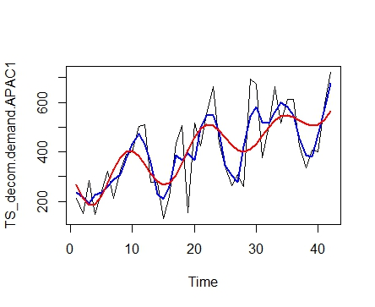
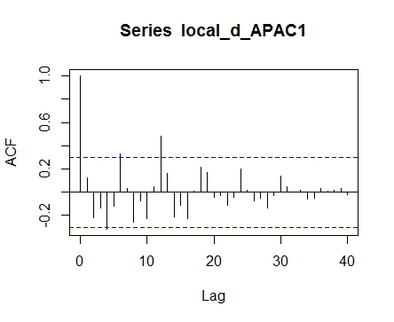
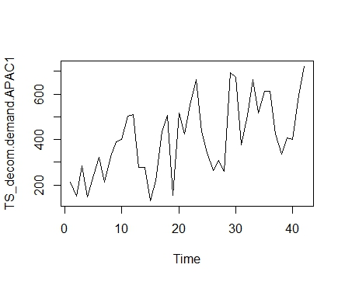
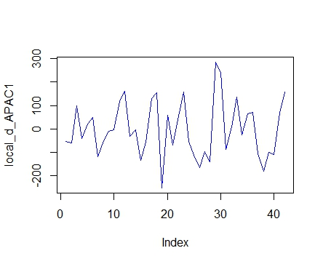
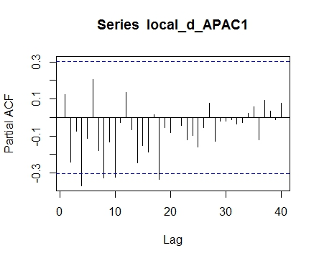
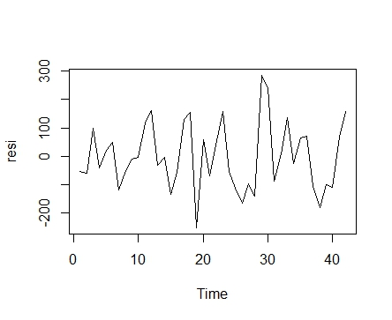
APAC Consumer Demand Curve
Global trend : In red
ACF of Local component
Actual APAC Demand Series
Local Component
PACF of Local component
Residuals
From ACF and PACF plots we see local component is almost stationary (<5% data pts. Cross 95% CF line)
Residuals are stationary as per DF test and KPSS test

Slide 7
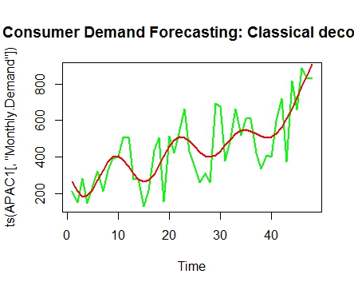
Comparing Auto ARIMA and Classical Decomposition Models for Demand- APAC
Forecasting using classical decomposition method
MAPE: 18.79196
Forecasting using Auto Arima Method
MAPE: 26.24458
Classical decomposition is doing a better job at forecasting as compared to Auto Arima.

Slide 8
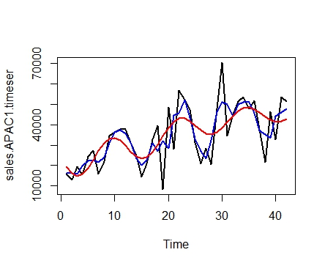
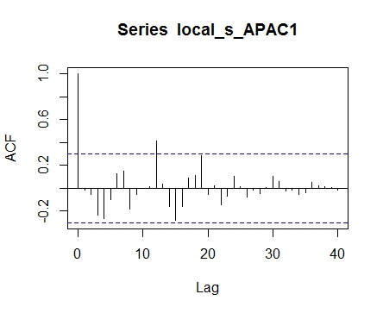
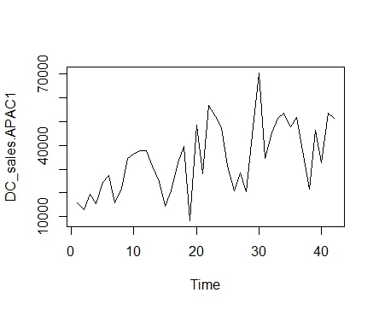
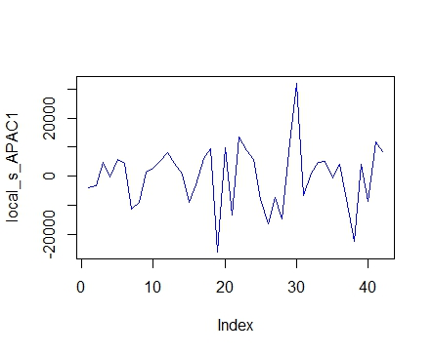
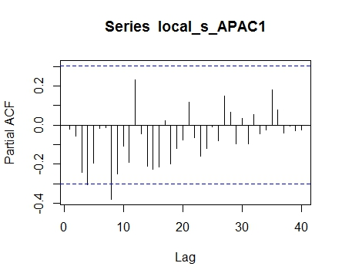
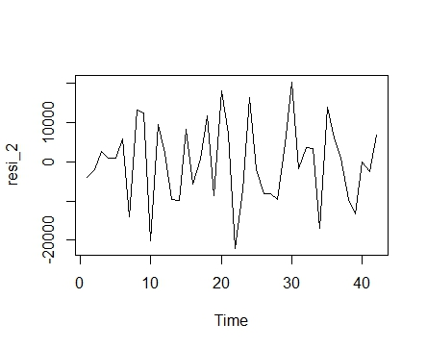
APAC Consumer Sales Curve
Global trend : In red
ACF of Local Component
Actual APAC Sales Series
Local Component
PACF of Local Component
Residuals
From ACF and PACF plots we see local component is almost stationary (<5% data pts. 95% Cross CF line)
Residuals are stationary as per DF test and KPSS test

Slide 9
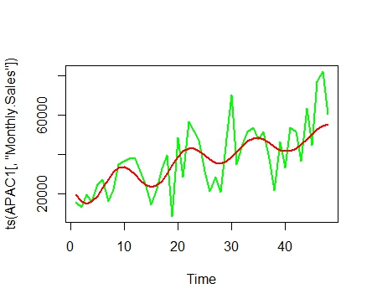
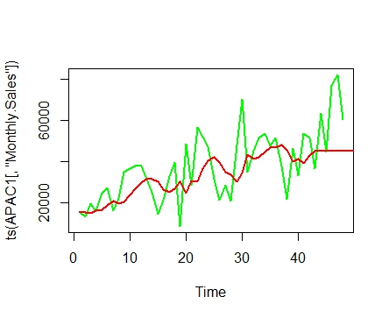
Comparing Auto ARIMA and Classical Decomposition Models for Sales- APAC
Forecasting using classical decomposition method
MAPE: 22.53589
Forecasting using Auto Arima Method
MAPE: 27.68952
Classical decomposition is doing a better job at forecasting as compared to Auto Arima.

Slide 10
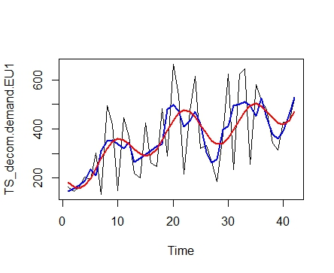
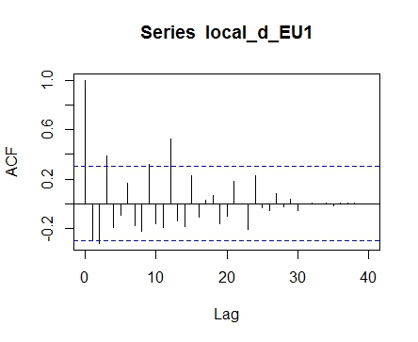
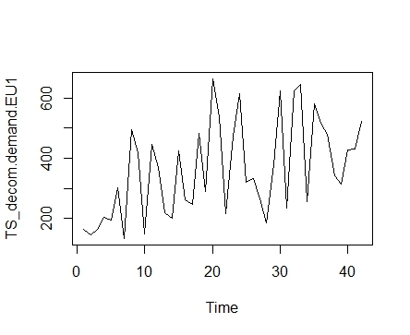
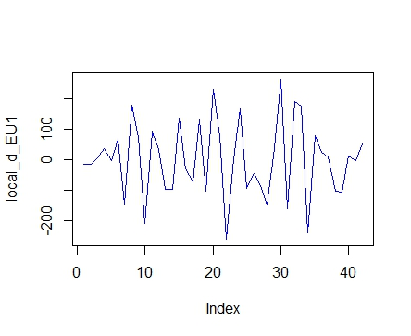
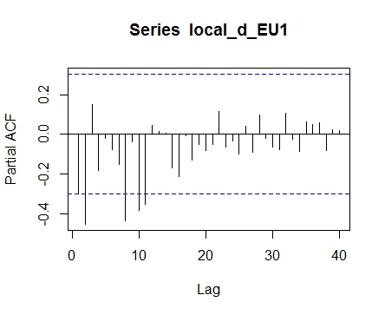
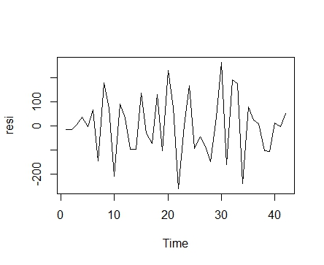
EU Consumer Demand Curve
Global trend : In red
ACF of Local Component
Actual EU Demand Series
Local Component
PACF of Local Component
Residuals
From ACF and PACF plots we see local component is almost stationary (<5% data pts. Cross 95% CF line)
Residuals are stationary as per DF test and KPSS test

Slide 11
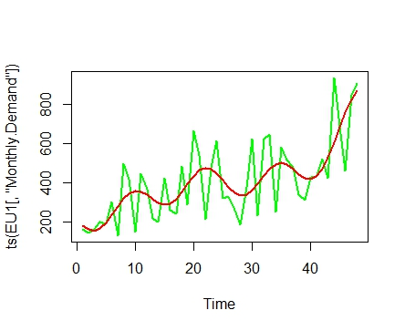
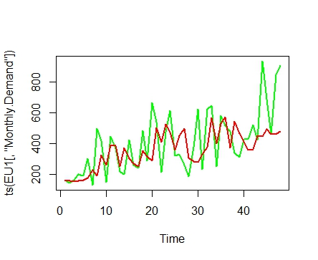
Comparing Auto ARIMA and Classical Decomposition Models for Demand - EU
Forecasting using classical decomposition method
MAPE: 22.18186
Forecasting using Auto Arima Method
MAPE: 30.13319
Classical decomposition is doing a better job at forecasting as compared to Auto Arima.

Slide 12
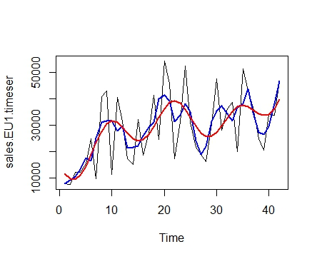
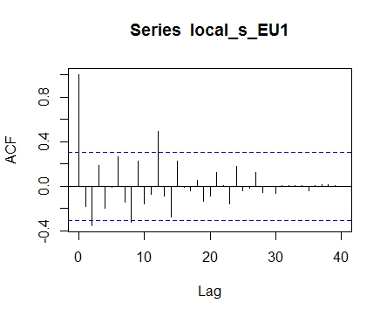
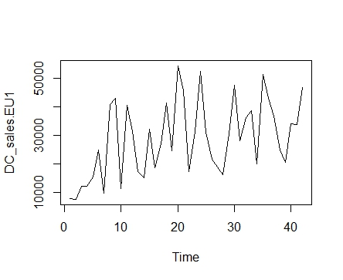
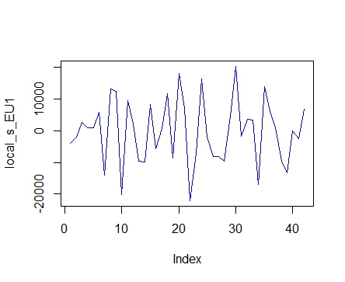
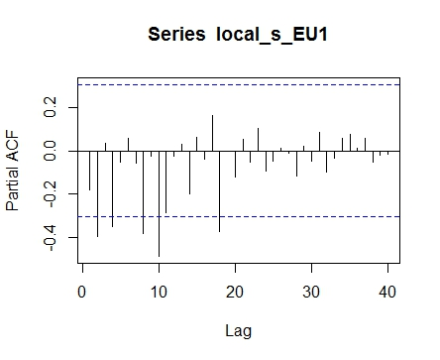
EU Consumer Sales Curve
Global trend : In red
ACF of Local Component
Actual EU Sales Series
Local Component
PACF of Local Component
Residuals
From ACF and PACF plots we see local component is almost stationary (<5% data pts. Cross 95% CF line)
Residuals are stationary as per DF test and KPSS test

Slide 13
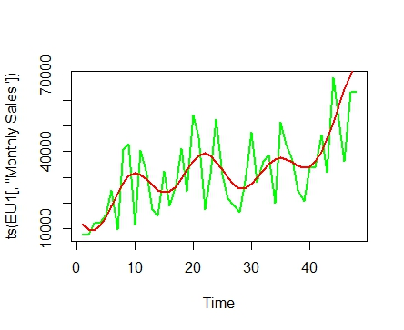
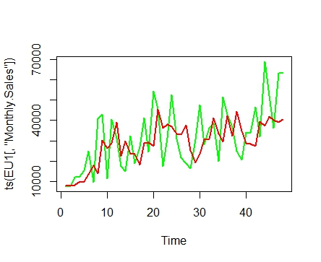
Comparing Auto ARIMA and Classical Decomposition Models for Sales - EU
Forecasting using classical decomposition method
MAPE: 30.69751
Forecasting using Auto Arima Method
MAPE: 28.9226
Auto Arima is doing a better job in forecasting as compared to Classical Decomposition.

Slide 14
Conclusions
The two most profitable buckets out of 21 are EU Consumer and APAC Consumer segment.
The MAPE values of all the predictions are in moderately acceptable range.
Classical decomposition Method is doing a better forecast in most of the cases.
For both the segments sales and demand follow a seasonal pattern and show an overall increasing trend.
The ACF,PACF plots for all the segments shows that the local component of the series are weakly stationary (<5% of the lines are crossing the confidence interval boundary) and residuals for all the segments are pure white noise.

